Slide 1

Sales Performance Dashboard for Retail Businesses
Prepared by:- Abhinav kakkeri

Slide 2
Introduction
This report presents an analysis of the *Retail Sales Performance Dashboard*, which provides insights into revenue and profit trends across various product categories, states, cities, and time periods. The objective is to interpret the data, identify key patterns, and offer recommendations for optimizing sales strategies..

Slide 3
Acknowledgment
We extend our sincere appreciation to all contributors who played a key role in the creation and analysis of this *Retail Sales Performance Report*. Special thanks to the data analysts, business strategists, and decision-makers who provided valuable insights, helping translate raw sales figures into meaningful strategies.

Slide 4
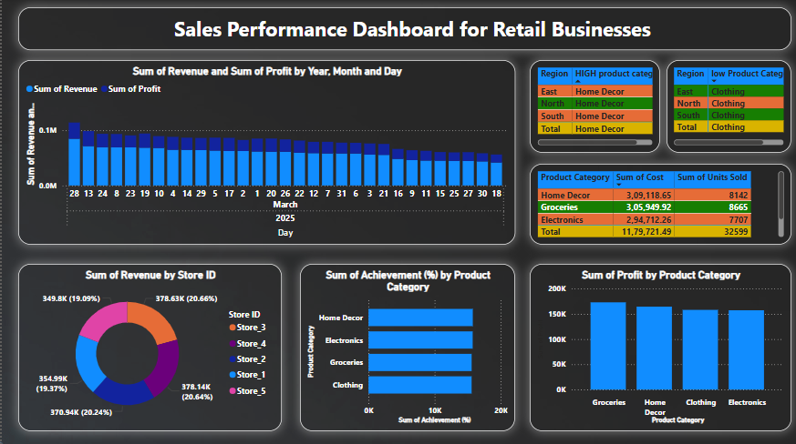
Dashboard

Slide 5
Key Findings
A) Revenue Analysis:-
The *Average Revenue* is distributed across different product categories, states, cities, and time periods.-
The *Sum of Revenue by State ID* indicates which states contribute the most to total revenue.-
The *Sum of Revenue and Profit by Week and Day* provides insights into the best-performing days in terms of sales

Slide 6
Key Findings
B) Profitability Insights:-
The *Sum of Revenue and Profit by Product Category* highlights the most profitable product categories.
The *Sum of Profit by Product Category* further distinguishes the revenue-driving categories from those with lower profit margins.
C) Comparative Sales Analysis:-
The dashboard contains bar charts comparing revenue and profit across different parameters, aiding in business decision-making.
The *tables for Product Category and State* summarize profit and revenue distributions

Slide 7
Recommendation
Focus on high-revenue states for regional marketing campaigns.
Optimize pricing and promotional offers for high-performing product categories.
Identify the most profitable sales periods and adjust marketing efforts accordingly.

Slide 8
Conclusion
The Retail Sales Performance Dashboard provides valuable insights into revenue and profit trends, helping businesses make data-driven decisions. By focusing on high-revenue states, optimizing product category strategies, and leveraging peak sales periods, companies can improve profitability and enhance customer engagement

Slide 9


